Slide 1
Data Visualization and Estimation with Python.
Nigeria’s Stock Exchange Values for Six Years.
By Confidence Jackmay

Slide 2
Key Terms.
Open:- The opening price the stock started trading at when the exchange opened.
High:- The highest price the stock has seen that day.
Low:- The lowest price the stock has seen that day.
Adj Close:- Is a closing price on any given day of trading that has been amended to include any distributions and corporate activities.

Slide 3
Key Terms Continued…
Volume:- This shows the total number of shares traded for the day.
Close:- The last trading price recorded when the market closed on the day.

Slide 4
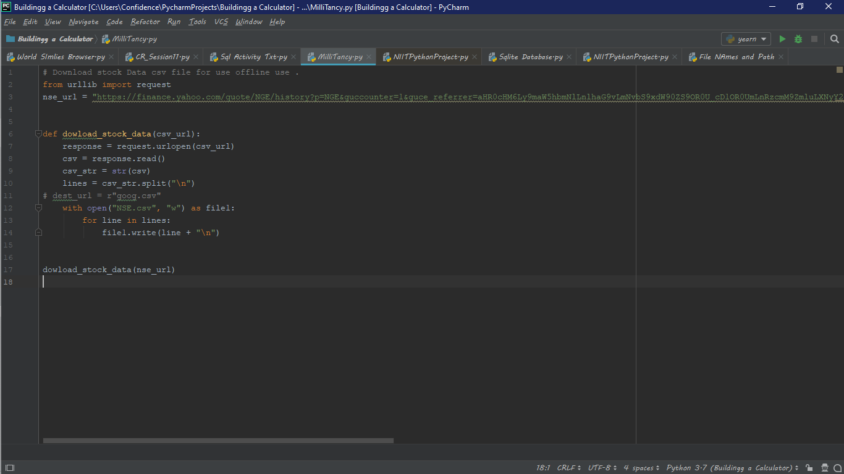
Notes:
My Pycharm user interface used to download dataframe.

Slide 5
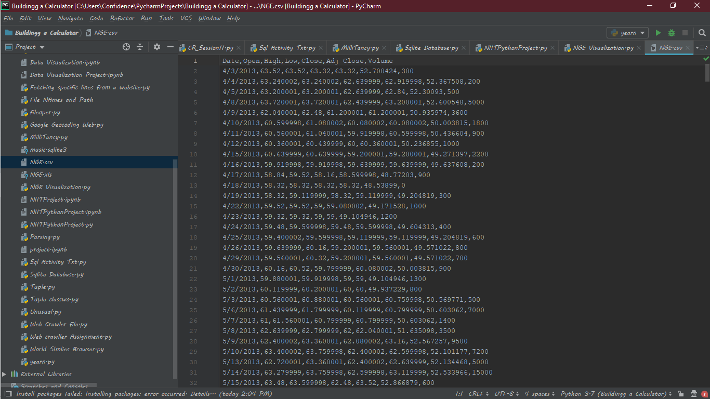

Slide 6
4/23/2019
NGE Analysis
# Import libraries necessary for this project
import numpy as np
from mpl_toolkits import mplot3d
import pandas as pd
import matplotlib.pyplot as plt
import sklearn as sk
from sklearn.pipeline import Pipeline
from sklearn.preprocessing import LabelEncoder
from sklearn.linear_model import Lasso
# Pretty display for notebooks
%matplotlib inline
# Load the NSE housing dataset
# stock_df = pd.read_csv("NGE.csv")
stock_df = pd.read_excel("NGE.xls", "NGE", index_col=None, na_values=['NA']) stock_df.head()
# print(stock_df.index())
Out[154]:
 |  | Date | Open | High | Low | Close | Adj Close | Volume
 | 0 | 2013-04-03 | 63.520000 | 63.520000 | 63.320000 | 63.320000 | 52.700424 | 300
 | 1 | 2013-04-04 | 63.240002 | 63.240002 | 62.639999 | 62.919998 | 52.367508 | 200
 | 2 | 2013-04-05 | 63.200001 | 63.200001 | 62.639999 | 62.840000 | 52.300930 | 500
 | 3 | 2013-04-08 | 63.720001 | 63.720001 | 62.439999 | 63.200001 | 52.600548 | 5000
 | 4 | 2013-04-09 | 62.040001 | 62.480000 | 61.200001 | 61.200001 | 50.935974 | 3600

Slide 7
4/23/2019
NGE Analysis
In [155]:
print(stock_df)

Slide 8
4/23/2019
NGE Analysis
 | Date | Open | High | Low | Close | Adj Close | Volume
0 | 2013-04-03 | 63.520000 | 63.520000 | 63.320000 | 63.320000 | 52.700424 | 300
1 | 2013-04-04 | 63.240002 | 63.240002 | 62.639999 | 62.919998 | 52.367508 | 200
2 | 2013-04-05 | 63.200001 | 63.200001 | 62.639999 | 62.840000 | 52.300930 | 500
3 | 2013-04-08 | 63.720001 | 63.720001 | 62.439999 | 63.200001 | 52.600548 | 5000
4 | 2013-04-09 | 62.040001 | 62.480000 | 61.200001 | 61.200001 | 50.935974 | 3600
5 | 2013-04-10 | 60.599998 | 61.080002 | 60.080002 | 60.080002 | 50.003815 | 1800
6 | 2013-04-11 | 60.560001 | 61.040001 | 59.919998 | 60.599998 | 50.436604 | 900
7 | 2013-04-12 | 60.360001 | 60.439999 | 60.000000 | 60.360001 | 50.236855 | 1000
8 | 2013-04-15 | 60.639999 | 60.639999 | 59.200001 | 59.200001 | 49.271397 | 2200
9 | 2013-04-16 | 59.919998 | 59.919998 | 59.639999 | 59.639999 | 49.637608 | 200
10 | 2013-04-17 | 58.840000 | 59.520000 | 58.160000 | 58.599998 | 48.772030 | 900
11 | 2013-04-18 | 58.320000 | 58.320000 | 58.320000 | 58.320000 | 48.538990 | 0
12 | 2013-04-19 | 58.320000 | 59.119999 | 58.320000 | 59.119999 | 49.204819 | 300
13 | 2013-04-22 | 59.520000 | 59.520000 | 59.000000 | 59.080002 | 49.171528 | 1000
14 | 2013-04-23 | 59.320000 | 59.320000 | 59.000000 | 59.000000 | 49.104946 | 1200
15 | 2013-04-24 | 59.480000 | 59.599998 | 59.480000 | 59.599998 | 49.604313 | 400
16 | 2013-04-25 | 59.400002 | 59.599998 | 59.119999 | 59.119999 | 49.204819 | 600
17 | 2013-04-26 | 59.639999 | 60.160000 | 59.200001 | 59.560001 | 49.571022 | 800
18 | 2013-04-29 | 59.560001 | 60.320000 | 59.200001 | 59.560001 | 49.571022 | 700
19 | 2013-04-30 | 60.160000 | 60.520000 | 59.799999 | 60.080002 | 50.003815 | 900
20 | 2013-05-01 | 59.880001 | 59.919998 | 59.000000 | 59.000000 | 49.104946 | 1300
21 | 2013-05-02 | 60.119999 | 60.200001 | 60.000000 | 60.000000 | 49.937229 | 800
22 | 2013-05-03 | 60.560001 | 60.880001 | 60.560001 | 60.759998 | 50.569771 | 500
23 | 2013-05-06 | 61.439999 | 61.799999 | 60.119999 | 60.799999 | 50.603062 | 7000
24 | 2013-05-07 | 61.000000 | 61.560001 | 60.799999 | 60.799999 | 50.603062 | 1400
25 | 2013-05-08 | 62.639999 | 62.799999 | 62.000000 | 62.040001 | 51.635098 | 3500
26 | 2013-05-09 | 62.400002 | 63.360001 | 62.080002 | 63.160000 | 52.567257 | 9500
27 | 2013-05-10 | 63.400002 | 63.759998 | 62.400002 | 62.599998 | 52.101177 | 7200
28 | 2013-05-13 | 62.720001 | 63.360001 | 62.400002 | 62.639999 | 52.134468 | 5000
29 | 2013-05-14 | 63.279999 | 63.759998 | 62.599998 | 63.119999 | 52.533966 | 15000
... | ... | ... | ... | ... | ... | ... | ...
1480 | 2019-02-19 | 18.200001 | 18.200001 | 17.770000 | 17.930000 | 17.930000 | 14900
1481 | 2019-02-20 | 17.790001 | 18.500000 | 17.790001 | 18.170000 | 18.170000 | 23100
1482 | 2019-02-21 | 18.370001 | 18.370001 | 17.930000 | 18.049999 | 18.049999 | 14100
1483 | 2019-02-22 | 18.330000 | 18.360001 | 18.000000 | 18.299999 | 18.299999 | 10900
1484 | 2019-02-25 | 18.500000 | 18.549999 | 18.160000 | 18.170000 | 18.170000 | 21700
1485 | 2019-02-26 | 18.150000 | 18.389999 | 17.809999 | 18.389999 | 18.389999 | 16500
1486 | 2019-02-27 | 18.040001 | 18.389999 | 17.709999 | 17.950001 | 17.950001 | 10100
1487 | 2019-02-28 | 17.559999 | 17.620001 | 17.139999 | 17.160000 | 17.160000 | 13700
1488 | 2019-03-01 | 17.520000 | 17.520000 | 17.260000 | 17.370001 | 17.370001 | 8100

Slide 9
4/23/2019
NGE Analysis
1489 | 2019-03-04 | 17.389999 | 18.080000 | 17.250000 | 17.500000 | 17.500000 | 22000
1490 | 2019-03-05 | 17.629999 | 18.070000 | 17.530001 | 17.879999 | 17.879999 | 31500
1491 | 2019-03-06 | 17.900000 | 17.900000 | 17.740000 | 17.740000 | 17.740000 | 2000
1492 | 2019-03-07 | 17.680000 | 17.730000 | 17.260000 | 17.600000 | 17.600000 | 14400
1493 | 2019-03-08 | 17.500000 | 17.889999 | 17.500000 | 17.520000 | 17.520000 | 6600
1494 | 2019-03-11 | 17.660000 | 17.969999 | 17.580000 | 17.639999 | 17.639999 | 7500
1495 | 2019-03-12 | 17.639999 | 17.639999 | 17.420000 | 17.450001 | 17.450001 | 10400
1496 | 2019-03-13 | 17.490000 | 17.510000 | 17.420000 | 17.510000 | 17.510000 | 7800
1497 | 2019-03-14 | 17.500000 | 17.500000 | 17.250000 | 17.250000 | 17.250000 | 7000
1498 | 2019-03-15 | 17.520000 | 17.549999 | 17.160000 | 17.260000 | 17.260000 | 17800
1499 | 2019-03-18 | 17.500000 | 17.500000 | 17.020000 | 17.360001 | 17.360001 | 19100
1500 | 2019-03-19 | 17.360001 | 17.440001 | 17.250000 | 17.350000 | 17.350000 | 2600
1501 | 2019-03-20 | 17.340000 | 17.379999 | 17.340000 | 17.379999 | 17.379999 | 1200
1502 | 2019-03-21 | 17.340000 | 17.379999 | 17.240000 | 17.379999 | 17.379999 | 16300
1503 | 2019-03-22 | 17.379999 | 17.379999 | 17.320000 | 17.320000 | 17.320000 | 500
1504 | 2019-03-25 | 17.250000 | 17.250000 | 17.110001 | 17.190001 | 17.190001 | 5300
1505 | 2019-03-26 | 17.190001 | 17.190001 | 17.059999 | 17.190001 | 17.190001 | 7800
1506 | 2019-03-27 | 17.020000 | 17.100000 | 17.000000 | 17.080000 | 17.080000 | 6800
1507 | 2019-03-28 | 17.000000 | 17.049999 | 17.000000 | 17.049999 | 17.049999 | 8600
1508 | 2019-03-29 | 17.000000 | 17.010000 | 16.860001 | 16.889999 | 16.889999 | 8200
1509 | 2019-04-01 | 16.809999 | 17.090000 | 16.809999 | 16.870001 | 16.870001 | 13700
[1510 rows x 7 columns]

Slide 10
4/23/2019
NGE Analysis
In [156]:
print(stock_df.describe())
print(stock_df.info())
count | Open 1510.000000 | High 1510.000000 | Low 1510.000000 | Close 1510.000000 | Adj Close 1510.000000 | \
mean | 34.032444 | 34.344556 | 33.649801 | 33.957901 | 29.667998
std | 17.380578 | 17.440182 | 17.279634 | 17.351200 | 13.773470
min | 14.750000 | 15.050000 | 14.650000 | 14.660000 | 13.619122
25% | 19.040001 | 19.265000 | 18.657500 | 19.040001 | 17.898098
50% | 25.225000 | 25.559999 | 24.659999 | 25.010000 | 22.969975
75% | 55.860000 | 56.060001 | 55.150001 | 55.779999 | 46.754610
max | 67.120003 | 67.279999 | 65.360001 | 65.480003 | 55.193237
count | Volume 1510.000000
mean | 16989.801325
std | 26273.659513
min | 0.000000
25% | 3500.000000
50% | 10100.000000
75% | 21900.000000
max | 455800.000000
<class | 'pandas.core.frame.DataFrame'>
RangeIndex: 1510 entries, 0 to 1509 Data columns (total 7 columns):
Date | 1510 | non-null | datetime64[ns]
Open | 1510 | non-null | float64
High | 1510 | non-null | float64
Low | 1510 | non-null | float64
Close | 1510 | non-null | float64
Adj Close | 1510 | non-null | float64
Volume | 1510 | non-null | int64
dtypes: datetime64[ns](1), float64(5), int64(1) memory usage: 82.6 KB
None

Slide 11
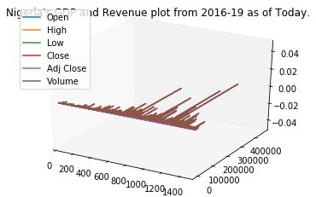
4/23/2019
NGE Analysis
In [157]:
fig = plt.figure()
ax = plt.axes(projection='3d')
plt.title("Nigeria's GDP and Revenue plot from 2016-19 as of Today.") stock_df['Open'].plot()
stock_df['High'].plot()
stock_df['Low'].plot() stock_df['Close'].plot() stock_df['Adj Close'].plot() stock_df['Volume'].plot()
plt.legend(['Open', 'High', 'Low', 'Close', 'Adj Close', 'Volume'])
Out[157]: <matplotlib.legend.Legend at 0x4d808bb0>

Slide 12
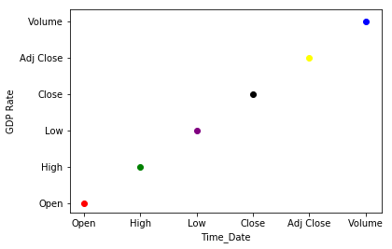
4/23/2019
NGE Analysis
In [158]:
plt.scatter('Open', 'Open', color='red') plt.scatter('High','High', color='green') plt.scatter('Low', 'Low', color='purple') plt.scatter('Close', 'Close', color='black') plt.scatter('Adj Close', 'Adj Close', color='yellow') plt.scatter('Volume', 'Volume', color='blue') plt.xlabel('Time_Date')
plt.ylabel('GDP Rate') plt.show()

Slide 13
4/23/2019
NGE Analysis
In [160]:
stock_df.groupby(['Open']).mean()
stock_df.groupby(['High']).mean()
stock_df.groupby(['Low']).mean() stock_df.groupby(['Close']).mean() stock_df.groupby(['Adj Close']).mean() stock_df.groupby(['Volume']).mean()

Slide 14
4/23/2019
NGE Analysis
Out[160]:
 |  | Open | High | Low | Close | Adj Close
 | Volume
 | 0 | 59.120000 | 59.173333 | 59.120000 | 59.173333 | 49.320638
 | 100 | 59.937143 | 60.331428 | 59.731429 | 60.182858 | 50.183932
 | 200 | 60.331429 | 60.468571 | 59.988571 | 60.217142 | 50.212723
 | 300 | 60.511111 | 60.760001 | 60.366667 | 60.588889 | 50.543184
 | 400 | 57.192727 | 57.498181 | 56.890909 | 57.109091 | 47.904823
 | 500 | 55.380000 | 55.932727 | 55.029091 | 55.581818 | 46.700531
 | 600 | 58.781177 | 58.898824 | 58.310588 | 58.618823 | 49.207435
 | 700 | 58.952728 | 59.312728 | 58.410910 | 58.832727 | 49.135836
 | 800 | 50.538572 | 50.860714 | 50.262143 | 50.543572 | 42.859179
 | 900 | 59.670770 | 59.870770 | 59.126154 | 59.452308 | 49.575608
 | 1000 | 55.341334 | 55.653333 | 54.970667 | 55.376000 | 46.496397
 | 1100 | 51.118461 | 51.287692 | 50.730000 | 50.890000 | 43.007520
 | 1200 | 50.030000 | 50.317500 | 49.730000 | 49.918333 | 42.325076
 | 1300 | 50.350000 | 50.797778 | 49.991111 | 50.424445 | 42.756843
 | 1400 | 51.768182 | 52.082727 | 51.486364 | 51.624546 | 43.598359
 | 1500 | 50.649000 | 51.193000 | 50.347000 | 50.762000 | 43.070385
 | 1600 | 53.803636 | 54.269091 | 53.454546 | 53.883637 | 45.522793
 | 1700 | 56.060000 | 56.161111 | 55.351112 | 55.530000 | 46.765418
 | 1800 | 45.094445 | 45.263334 | 44.752222 | 44.896666 | 38.482272
 | 1900 | 40.496667 | 40.936666 | 40.086667 | 40.499999 | 34.573151
 | 2000 | 46.360667 | 46.662001 | 45.990000 | 46.306667 | 39.553370
 | 2100 | 56.435555 | 57.164444 | 56.017778 | 56.231111 | 47.276249
 | 2200 | 53.236364 | 53.678183 | 52.757272 | 53.119092 | 44.735181
 | 2300 | 42.890000 | 43.166667 | 42.364444 | 42.690000 | 36.541277

Slide 15
4/23/2019
Volume | Open | High | Low | Close | Adj Close | NGE Analysis
2400 | 45.985000 | 46.443333 | 45.183332 | 45.451665 | 38.598404
2500 | 46.198750 | 46.601250 | 45.886250 | 46.197500 | 39.510520
2600 | 37.926428 | 38.158571 | 37.461429 | 37.785000 | 32.734597
2700 | 36.504667 | 36.719333 | 36.179334 | 36.430000 | 31.775125
2800 | 43.722222 | 44.215555 | 43.329999 | 43.721111 | 37.579318
2900 | 47.065000 | 47.682500 | 46.867500 | 47.147501 | 40.138414
... | ... | ... | ... | ... | ...
81600 | 25.480000 | 25.600000 | 24.639999 | 25.320000 | 22.951845
81900 | 20.049999 | 20.100000 | 19.820000 | 19.990000 | 18.930317
82200 | 19.200001 | 19.400000 | 18.440001 | 18.799999 | 17.041655
83900 | 26.559999 | 27.240000 | 25.639999 | 25.639999 | 23.241917
84600 | 23.840000 | 25.480000 | 21.480000 | 21.600000 | 19.579773
86400 | 28.559999 | 29.160000 | 28.200001 | 28.760000 | 24.947542
88300 | 18.299999 | 18.299999 | 17.750000 | 17.850000 | 16.903761
89400 | 26.379999 | 26.420000 | 25.799999 | 26.250000 | 24.858471
90500 | 26.030001 | 26.090000 | 25.660000 | 25.690001 | 24.328157
95600 | 16.150000 | 16.150000 | 15.550000 | 15.700000 | 14.585279
95800 | 24.000000 | 24.100000 | 23.510000 | 24.049999 | 22.775093
99700 | 26.590000 | 26.940001 | 26.000000 | 26.850000 | 25.426664
104100 | 22.870001 | 23.070000 | 22.680000 | 23.070000 | 21.847044
111000 | 20.010000 | 20.940001 | 19.600000 | 20.940001 | 19.829958
112100 | 17.959999 | 19.280001 | 17.160000 | 19.040001 | 17.259207
117000 | 22.049999 | 22.049999 | 21.320000 | 21.450001 | 19.927023
120000 | 17.000000 | 17.080000 | 16.520000 | 16.799999 | 15.228713
124500 | 23.600000 | 23.980000 | 23.549999 | 23.620001 | 22.367889

Slide 16
4/23/2019
Volume | Open | High | Low | Close | Adj Close | NGE Analysis
125900 | 20.809999 | 20.889999 | 20.160000 | 20.629999 | 19.165243
132300 | 26.520000 | 26.870001 | 26.000000 | 26.410000 | 25.009989
134600 | 24.320000 | 24.799999 | 24.120001 | 24.480000 | 22.190411
136400 | 21.150000 | 21.190001 | 20.930000 | 21.059999 | 19.943596
140700 | 16.510000 | 16.820000 | 16.400000 | 16.730000 | 15.542148
149000 | 18.680000 | 19.100000 | 18.570000 | 18.820000 | 17.483755
154400 | 17.650000 | 18.680000 | 17.650000 | 18.240000 | 16.944937
185800 | 22.270000 | 23.170000 | 22.270000 | 22.530001 | 21.335670
253300 | 15.360000 | 15.850000 | 14.800000 | 14.850000 | 13.795631
324400 | 27.360001 | 27.360001 | 23.120001 | 23.639999 | 21.428974
363100 | 21.200001 | 22.100000 | 21.200001 | 21.660000 | 20.122112
455800 | 24.090000 | 24.150000 | 23.450001 | 23.540001 | 22.292130
457 rows × 5 columns
In [161]:
# we get the entire column of the feature we need to encode
openList = stock_df['Open'].tolist()
# we instantiate a LabelEncoder, fit it to the column, and transform it into a list of numbers, which go back into our DataFrame.
labelEncoderOpen = LabelEncoder() labelEncoderOpen.fit(openList)
labelOpen=labelEncoderOpen.transform(openList) stock_df['Open']=pd.Series(labelOpen)

Slide 17

4/24/2019
NGE Analysis
In [18]:
stock_df.sort_values('Volume', ascending=False) stock_df.sort_values('Open', ascending=False) stock_df.sort_values('High', ascending=False) stock_df.sort_values('Low', ascending=False) stock_df.sort_values('Close', ascending=False) stock_df.sort_values('Adj Close', ascending=False)

Slide 18
4/24/2019
NGE Analysis
Out[18]:
 |  | Date | Open | High | Low | Close | Adj Close | Volume
 | 320 | 2014-07-10 | 874 | 65.599998 | 64.919998 | 65.440002 | 55.193237 | 4400
 | 315 | 2014-07-02 | 848 | 65.400002 | 63.840000 | 65.400002 | 55.159504 | 48900
 | 317 | 2014-07-07 | 869 | 65.440002 | 64.680000 | 65.320000 | 55.092026 | 3300
 | 321 | 2014-07-11 | 868 | 65.400002 | 64.800003 | 65.239998 | 55.024555 | 11500
 | 316 | 2014-07-03 | 872 | 65.400002 | 64.639999 | 65.120003 | 54.923347 | 8300
 | 319 | 2014-07-09 | 869 | 65.760002 | 64.959999 | 64.959999 | 54.788399 | 4100
 | 202 | 2014-01-21 | 872 | 65.919998 | 64.400002 | 64.919998 | 54.754665 | 12300
 | 324 | 2014-07-16 | 863 | 65.559998 | 64.559998 | 64.879997 | 54.720924 | 8700
 | 322 | 2014-07-14 | 873 | 65.480003 | 64.760002 | 64.879997 | 54.720924 | 1700
 | 323 | 2014-07-15 | 867 | 65.320000 | 64.680000 | 64.800003 | 54.653454 | 1400
 | 326 | 2014-07-18 | 862 | 64.760002 | 64.519997 | 64.680000 | 54.552238 | 300
 | 47 | 2013-06-10 | 880 | 67.279999 | 65.239998 | 65.480003 | 54.498169 | 23100
 | 318 | 2014-07-08 | 860 | 65.080002 | 64.440002 | 64.599998 | 54.484764 | 2700
 | 191 | 2014-01-03 | 861 | 64.959999 | 64.360001 | 64.599998 | 54.484764 | 6900
 | 48 | 2013-06-11 | 870 | 66.160004 | 65.120003 | 65.440002 | 54.464874 | 2900
 | 40 | 2013-05-30 | 882 | 67.120003 | 65.360001 | 65.440002 | 54.464874 | 6500
 | 199 | 2014-01-15 | 865 | 64.800003 | 64.040001 | 64.519997 | 54.417290 | 2800
 | 204 | 2014-01-23 | 853 | 64.800003 | 63.680000 | 64.440002 | 54.349823 | 4000
 | 329 | 2014-07-23 | 859 | 64.800003 | 64.080002 | 64.440002 | 54.349823 | 1000
 | 200 | 2014-01-16 | 844 | 64.639999 | 63.599998 | 64.400002 | 54.316086 | 3200
 | 314 | 2014-07-01 | 840 | 64.760002 | 63.400002 | 64.400002 | 54.316086 | 9700
 | 328 | 2014-07-22 | 857 | 64.720001 | 64.120003 | 64.400002 | 54.316086 | 3300
 | 45 | 2013-06-06 | 875 | 65.680000 | 65.080002 | 65.239998 | 54.298412 | 600
 | 198 | 2014-01-14 | 851 | 64.360001 | 63.680000 | 64.360001 | 54.282349 | 2000
 | 309 | 2014-06-24 | 857 | 64.400002 | 63.880001 | 64.239998 | 54.181137 | 13300

Slide 19
4/24/2019
NGE Analysis
 | Date | Open | High | Low | Close | Adj Close | Volume
44 | 2013-06-05 | 877 | 65.959999 | 65.080002 | 65.080002 | 54.165253 | 400
331 | 2014-07-25 | 850 | 64.559998 | 63.720001 | 64.199997 | 54.147400 | 600
201 | 2014-01-17 | 860 | 64.599998 | 64.199997 | 64.199997 | 54.147400 | 2800
189 | 2013-12-31 | 858 | 64.480003 | 64.000000 | 64.160004 | 54.113670 | 2200
327 | 2014-07-21 | 856 | 64.440002 | 64.080002 | 64.160004 | 54.113670 | 4300
... | ... | ... | ... | ... | ... | ... | ...
974 | 2017-02-13 | 27 | 16.160000 | 15.600000 | 15.640000 | 14.529540 | 18400
991 | 2017-03-09 | 27 | 16.000000 | 15.600000 | 15.600000 | 14.492380 | 36300
992 | 2017-03-10 | 24 | 15.920000 | 15.520000 | 15.600000 | 14.492380 | 28600
1000 | 2017-03-22 | 20 | 15.830000 | 15.600000 | 15.600000 | 14.492380 | 26300
1014 | 2017-04-11 | 18 | 15.800000 | 15.550000 | 15.590000 | 14.483089 | 77300
1044 | 2017-05-24 | 7 | 15.640000 | 15.450000 | 15.570000 | 14.464510 | 7600
981 | 2017-02-23 | 20 | 15.840000 | 15.440000 | 15.560000 | 14.455220 | 58000
979 | 2017-02-21 | 20 | 15.800000 | 15.480000 | 15.560000 | 14.455220 | 41000
1015 | 2017-04-12 | 16 | 15.780000 | 15.510000 | 15.550000 | 14.445930 | 41500
1038 | 2017-05-16 | 12 | 15.780000 | 15.200000 | 15.540000 | 14.436640 | 53600
1042 | 2017-05-22 | 10 | 15.760000 | 15.500000 | 15.540000 | 14.436640 | 43400
1034 | 2017-05-10 | 2 | 15.680000 | 15.030000 | 15.520000 | 14.418060 | 71900
978 | 2017-02-17 | 12 | 15.720000 | 15.360000 | 15.520000 | 14.418060 | 32800
1043 | 2017-05-23 | 14 | 15.670000 | 15.500000 | 15.500000 | 14.399480 | 6600
1040 | 2017-05-18 | 5 | 15.600000 | 15.300000 | 15.490000 | 14.390190 | 36500
988 | 2017-03-06 | 11 | 15.680000 | 15.400000 | 15.480000 | 14.380900 | 30900
984 | 2017-02-28 | 11 | 15.560000 | 15.320000 | 15.440000 | 14.343740 | 33300
983 | 2017-02-27 | 11 | 15.600000 | 15.440000 | 15.440000 | 14.343740 | 23200
982 | 2017-02-24 | 11 | 15.760000 | 15.320000 | 15.400000 | 14.306580 | 41500
975 | 2017-02-14 | 11 | 15.760000 | 15.400000 | 15.400000 | 14.306580 | 25500

Slide 20
4/24/2019
NGE Analysis
 | Date | Open | High | Low | Close | Adj Close | Volume
1041 | 2017-05-19 | 4 | 15.490000 | 15.310000 | 15.370000 | 14.278710 | 40900
987 | 2017-03-03 | 3 | 15.640000 | 15.280000 | 15.360000 | 14.269420 | 11500
977 | 2017-02-16 | 8 | 15.600000 | 15.320000 | 15.360000 | 14.269420 | 26700
976 | 2017-02-15 | 6 | 15.600000 | 15.280000 | 15.320000 | 14.232260 | 26800
985 | 2017-03-01 | 6 | 15.480000 | 15.240000 | 15.280000 | 14.195101 | 33400
986 | 2017-03-02 | 2 | 15.280000 | 15.160000 | 15.280000 | 14.195101 | 26300
1039 | 2017-05-17 | 9 | 15.790000 | 15.230000 | 15.260000 | 14.176520 | 55900
1033 | 2017-05-09 | 1 | 15.060000 | 14.710000 | 14.850000 | 13.795631 | 61100
1031 | 2017-05-05 | 3 | 15.850000 | 14.800000 | 14.850000 | 13.795631 | 253300
1032 | 2017-05-08 | 0 | 15.050000 | 14.650000 | 14.660000 | 13.619122 | 54500
1510 rows × 7 columns

Slide 21
4/23/2019
NGE Analysis
In [172]:
# we also need to prepare the training and test splits for the data. The following function does that.
def prepareDataset(stock_df):
#Keep track of the features
headers = list(stock_df)
#Store the revenues separately in a list YIndex = headers.index('Open') datasetMatrix = stock_df.as_matrix()
#Make the train and test splits
datasetTrain = datasetMatrix[0:1500] datasetTrainWithoutLabels = np.delete(datasetTrain,YIndex,1)
labels = datasetTrain[:,YIndex]
datasetTest = datasetMatrix[1500:datasetMatrix.shape[0]] datasetTestWithoutLabels = np.delete(datasetTest,YIndex,1)
trueLabels = datasetTest[:,YIndex]
return headers, datasetMatrix, datasetTrainWithoutLabels, labels, datasetTest, datasetTestWithoutLabels,trueLabels prepareDataset(stock_df)

Slide 22
4/23/2019
NGE Analysis
c:\users\confidence\appdata\local\programs\python\python37-32\lib\site-packages\ipykernel_launcher.py:9: FutureWarnin g: Method .as_matrix will be removed in a future version. Use .values instead.
if name == ' main ':

Slide 23
4/23/2019
NGE Analysis
Out[172]:
(['Date', 'Open', 'High', 'Low', 'Close', 'Adj Close', 'Volume'],
array([[Timestamp('2013-04-03 00:00:00'), 842, 63.52, ..., 63.32,
52.700424, 300],
[Timestamp('2013-04-04 00:00:00'), 835, 63.240002, ..., 62.919998,
52.367508, 200],
[Timestamp('2013-04-05 00:00:00'), 834, 63.200001, ..., 62.84,
52.30093, 500],
...,
[Timestamp('2019-03-28 00:00:00'), 77, 17.049999, ..., 17.049999,
17.049999, 8600],
[Timestamp('2019-03-29 00:00:00'), 77, 17.01, ..., 16.889999,
16.889999, 8200],
[Timestamp('2019-04-01 00:00:00'), 67, 17.09, ..., 16.870001,
16.870001, 13700]], dtype=object),
array([[Timestamp('2013-04-03 00:00:00'), 63.52, 63.32, 63.32, 52.700424,
300],
[Timestamp('2013-04-04 | 00:00:00'), | 63.240002, 62.639999,
62.919998, 52.367508, | 200],
[Timestamp('2013-04-05 | 00:00:00'), | 63.200001, 62.639999, 62.84,
52.30093, 500],
...,
[Timestamp('2019-03-14 00:00:00'), 17.5, 17.25, 17.25, 17.25,
7000],
[Timestamp('2019-03-15 00:00:00'), 17.549999, 17.16, 17.26, 17.26,
17800],
[Timestamp('2019-03-18 00:00:00'), 17.5, 17.02, 17.360001,
17.360001, 19100]], dtype=object),
array([842, 835, 834, ..., 107, 109, 107], dtype=object),
array([[Timestamp('2019-03-19 | 00:00:00'), | 99, | 17.440001, | 17.25, 17.35,
17.35, 2600],
[Timestamp('2019-03-20 | 00:00:00'), | 98, | 17.379999, | 17.34,
17.379999, 17.379999, | 1200],
[Timestamp('2019-03-21 | 00:00:00'), | 98, | 17.379999, | 17.24,
17.379999, 17.379999, | 16300],
[Timestamp('2019-03-22 00:00:00'), 100, 17.379999, 17.32, 17.32,
17.32, 500],
[Timestamp('2019-03-25 | 00:00:00'), | 92, | 17.25, 17.110001,
17.190001, 17.190001, | 5300],
[Timestamp('2019-03-26 | 00:00:00'), | 88, | 17.190001, 17.059999,
17.190001, 17.190001, | 7800],
[Timestamp('2019-03-27 | 00:00:00'), | 79, | 17.1, 17.0, 17.08, 17.08,

Slide 24
4/23/2019
NGE Analysis
6800],
[Timestamp('2019-03-28 00:00:00'), 77, 17.049999, 17.0, 17.049999,
17.049999, 8600],
[Timestamp('2019-03-29 | 00:00:00'), | 77, | 17.01, 16.860001,
16.889999, 16.889999, | 8200],
[Timestamp('2019-04-01 | 00:00:00'), | 67, | 17.09, 16.809999,
16.870001, 16.870001, 13700]], dtype=object),
array([[Timestamp('2019-03-19 00:00:00'), 17.440001, 17.25, 17.35, 17.35,
2600],
[Timestamp('2019-03-20 00:00:00'), 17.379999, 17.34, 17.379999,
17.379999, 1200],
[Timestamp('2019-03-21 00:00:00'), 17.379999, 17.24, 17.379999,
17.379999, 16300],
[Timestamp('2019-03-22 00:00:00'), 17.379999, 17.32, 17.32, 17.32,
500],
[Timestamp('2019-03-25 00:00:00'), 17.25, 17.110001, 17.190001,
17.190001, 5300],
[Timestamp('2019-03-26 | 00:00:00'), | 17.190001, 17.059999,
17.190001, 17.190001, | 7800],
[Timestamp('2019-03-27 | 00:00:00'), | 17.1, 17.0, 17.08, 17.08, 6800],
[Timestamp('2019-03-28 | 00:00:00'), | 17.049999, 17.0, 17.049999,
17.049999, 8600],
[Timestamp('2019-03-29 00:00:00'), 17.01, 16.860001, 16.889999,
16.889999, 8200],
[Timestamp('2019-04-01 00:00:00'), 17.09, 16.809999, 16.870001,
16.870001, 13700]], dtype=object),
array([99, 98, 98, 100, 92, 88, 79, 77, 77, 67], dtype=object))
In [163]:
# we initialize a Lasso regressor object and define the range of alphas we plan to search over to find the one that gi ves the best training accuracy determined by cross validation
regressor = Lasso() alphas = np.arange(1,50)
# Now, we build our pipeline. In our case, it has only one step, i.e. making predictions using the regression model:
steps = [('regressor',regressor)]
pipeline = Pipeline(steps) # define the pipeline object
parameterGrid = dict(regressor alpha = alphas)

Slide 25
4/23/2019
NGE Analysis
In [165]:
figures = stock_df['Adj Close'] prices = stock_df['Volume']
features = stock_df.drop('Volume', axis = 1)

Slide 26
4/23/2019
NGE Analysis
In [166]:
# Minimum price of the data
minimum_price = np.amin(prices)
# Maximum price of the data
maximum_price = np.amax(prices)
# Mean price of the data
mean_price = np.mean(prices)
# Median price of the data
median_price = np.median(prices)
# Standard deviation of prices of the data
std_price = np.std(prices)
# Show the calculated statistics print("Statistics for Nigeria's Stock dataset:\n") print("Minimum price: ${}".format(minimum_price)) print("Maximum price: ${}".format(maximum_price)) print("Mean price: ${}".format(mean_price)) print("Median price ${}".format(median_price))
print("Standard deviation of prices: ${}".format(std_price))
Statistics for Nigeria's Stock dataset:
Minimum price: $0 Maximum price: $455800
Mean price: $16989.80132450331 Median price $10100.0
Standard deviation of prices: $26264.95818457264

Slide 27
Understanding What’s coming next.
A stock chart is a numerical chart that helps readers understand how a stock is trading.
With this data, investors determine whether a stock should be bought or sold. It also aids the investor in calculating the financial return if they choose to sell a stock.

Slide 28
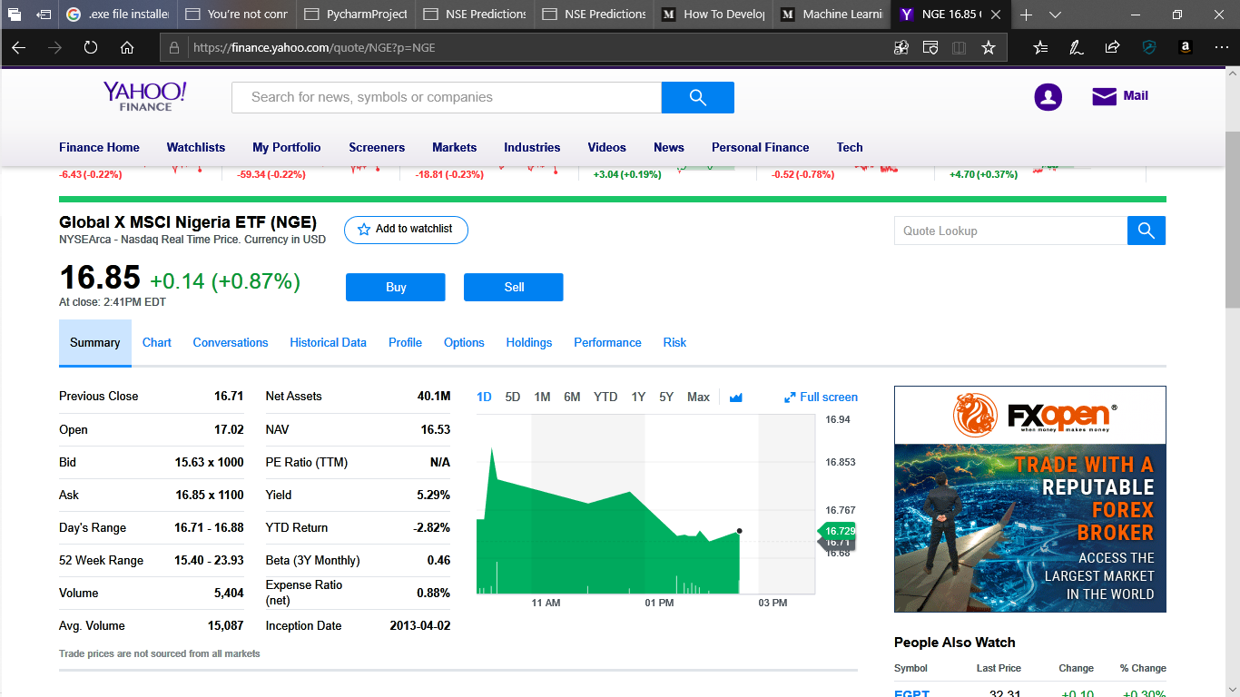
Major View of a Stock on a Brooker’s Website.

Slide 29
4/23/2019
NSE Predictions
In [168]:
import seaborn as sns
# Calculate and show pairplot sns.pairplot(stock_df, size=2.5) plt.tight_layout()
We will start by creating a scatterplot matrix that will allow us to visualize the pair-wise relationships and correlations between the different features.
It is also quite useful to have a quick overview of how the data is distributed and whether it contains or not outliers.

Slide 30
4/23/2019
NGE Analysis
c:\users\confidence\appdata\local\programs\python\python37-32\lib\site-packages\seaborn\axisgrid.py:2065: UserWarnin g: The `size` parameter has been renamed to `height`; pleaes update your code.
warnings.warn(msg, UserWarning)

Slide 31
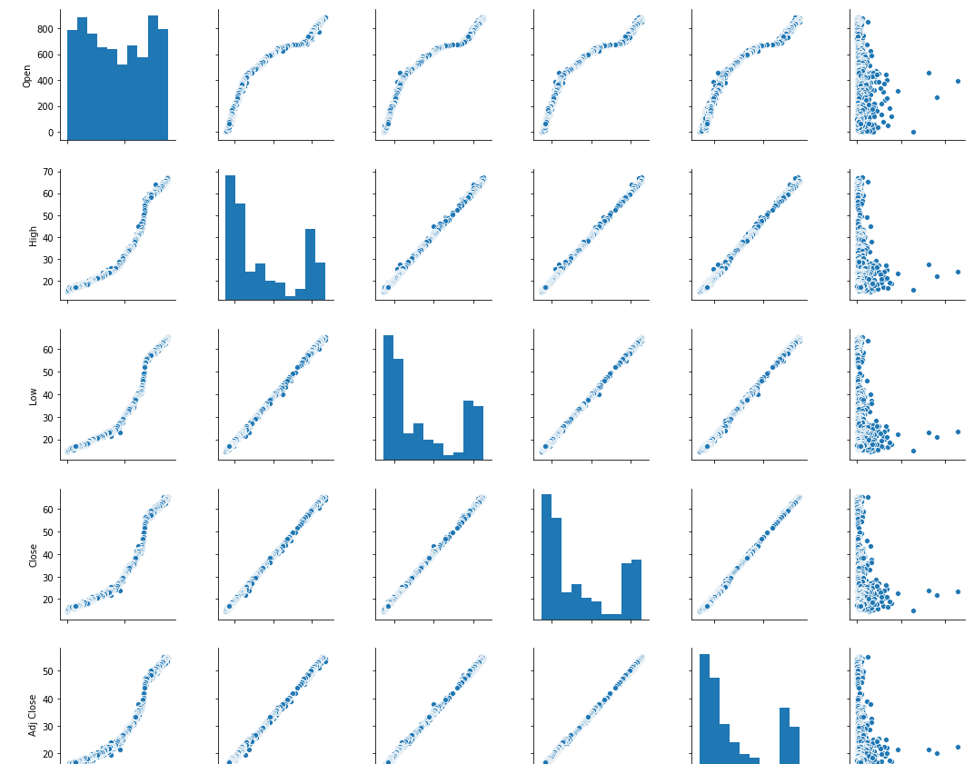
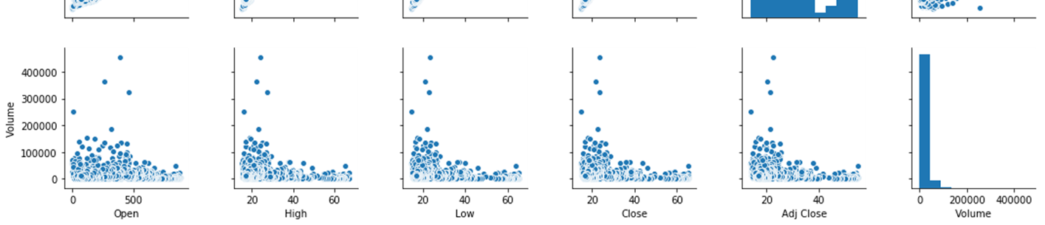
4/23/2019
NGE Analysis

Slide 32
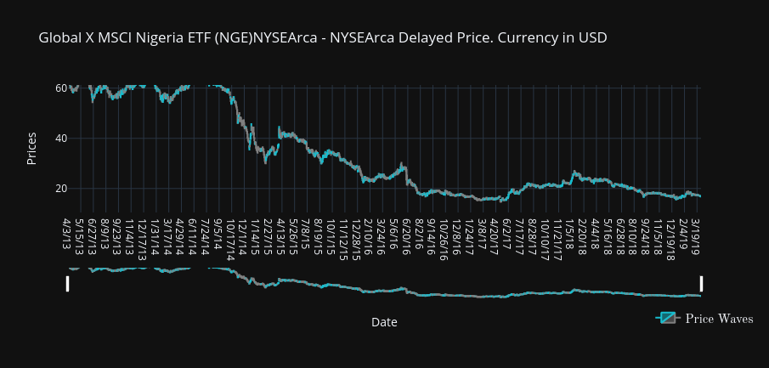

Slide 33
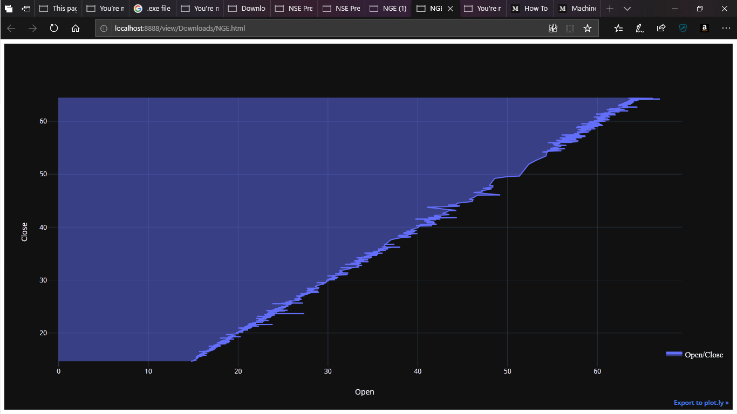

Slide 34
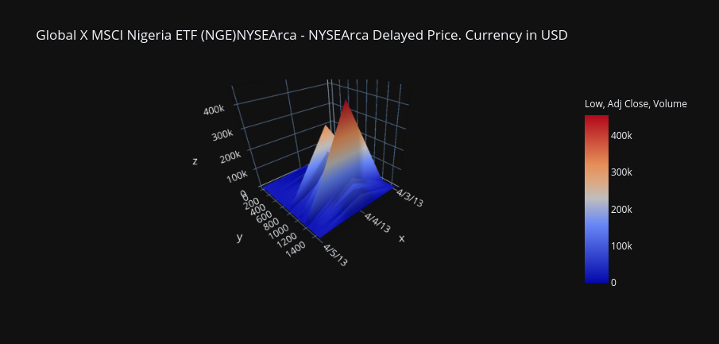

Slide 35
4/23/2019
NSE Predictions
In [169]:
# Import 'train_test_split'
from sklearn.model_selection import train_test_split
# Shuffle and split the data into training and testing subsets
X_train, X_test, y_train, y_test = train_test_split(features, prices, test_size=0.2, random_state = 42)
# Success
print("Training and testing split was successful.")
Training and testing split was successful.

Slide 36
Apparent End.
Thank You for your time.

